Slide 1
Data Flow Testing
Lesson 19

Slide 2

Introduction to Dataflow Testing
In the chapter on Software Testing, we run across this problem…

Slide 3
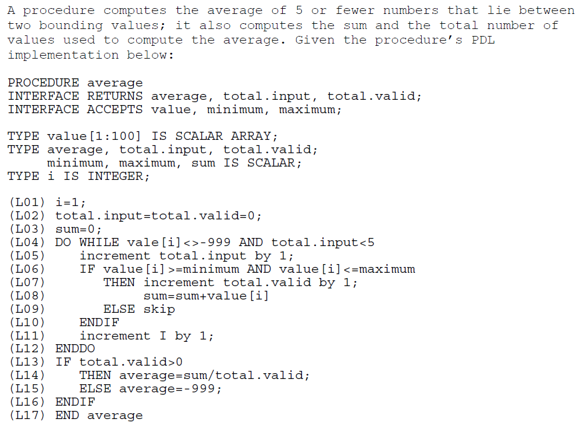
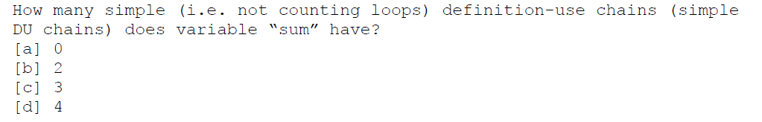

Slide 4
Some terminology first
d : where a variable is defined
    how can a variable be “defined”?
    var declarations, assignments, loop controls, proc declarations
u : where a variable is used
    how can a variable be “used”?
    assignments, loop controls, output statements
k : where a variable is killed
    how can a variable be “killed”?
    memory deallocation, uninstantiation, leaving a local function
a du-path respect to v is when there is a subpath in
the graph that begins with d(v) and ends with u(v)
Hey,
what
gives?
x := y + 1;
x is defined; y is used
x := x + 1;
x is defined and used

Slide 5
3 - 4 - 5 - 6 - 7 - 8
8 - 9 - 10 - 11 - 12 - 13 - 14
3 - 4 - 14
L03
L04
L09
L05
L10
L06
L11
L07
L12
1. Why does the question specify “simple”?
L08
L13
L08
2. Do you see any du-chains for sum? If so, where?
3. Where is another du-chain? (if there’s 1, there must be at least 2)
L14
4. Any more?

Slide 6
“Dataflow” testing is…
Not a very good word for what it is…
Looking at a particular variable’s definition and use…
…Looking for problematic patterns

Slide 7
Possible Problematic Patterns
~d | doesn’t exist, then gets defined | ◻OK? or ◻Not OK?
~u | variable doesn’t exist, then it gets used | ◻OK? or ◻Not OK?
~k (or ~x) | variable doesn’t exist, then it gets destroyed | ◻OK? or ◻Not OK?
dd | defined, then defined again | ◻OK? or ◻Not OK?
du | defined, then used | ◻OK? or ◻Not OK?
dk | defined, then killed | ◻OK? or ◻Not OK?
ud | used, then defined | ◻OK? or ◻Not OK?
uu | used, then used again | ◻OK? or ◻Not OK?
uk | used, then killed | ◻OK? or ◻Not OK?
kd | killed, then redefined | ◻OK? or ◻Not OK?
ku | killed, then used | ◻OK? or ◻Not OK?
kk | killed, then killed again | ◻OK? or ◻Not OK?
✓
✓
✓
✓
✓
✓
✓
✓
✓
✓
✓
✓

Slide 8
L03
L04
L09
As a matter of fact,
let’s change v from
sum to total.valid
L05
L10
L06
L11
L07
L12
1. Why does the question specify “simple”?
L08
L13
2. Do you see any du-chains? If so, where?
3. Where is another du-chain? (if there’s 1, there must be at least 2)
L14
4. Any more?
5. What is the significance of that last chain (from a testing perspective)?

Slide 9
L02
L03
L03
L03
L04
L09
L04
L04
As a matter of fact,
let’s change v from
sum to total.valid
L05
L10
L05
L05
L06
L11
L06
L06
L07
L12
L07
L07
1. Why does the question specify “simple”?
L08
L13
L08
L08
2. Do you see any du-chains? If so, where?
3. Where is another du-chain? (if there’s 1, there must be at least 2)
L14
4. Any more?
5. What is the significance of that last chain (from a testing perspective)?

Slide 10
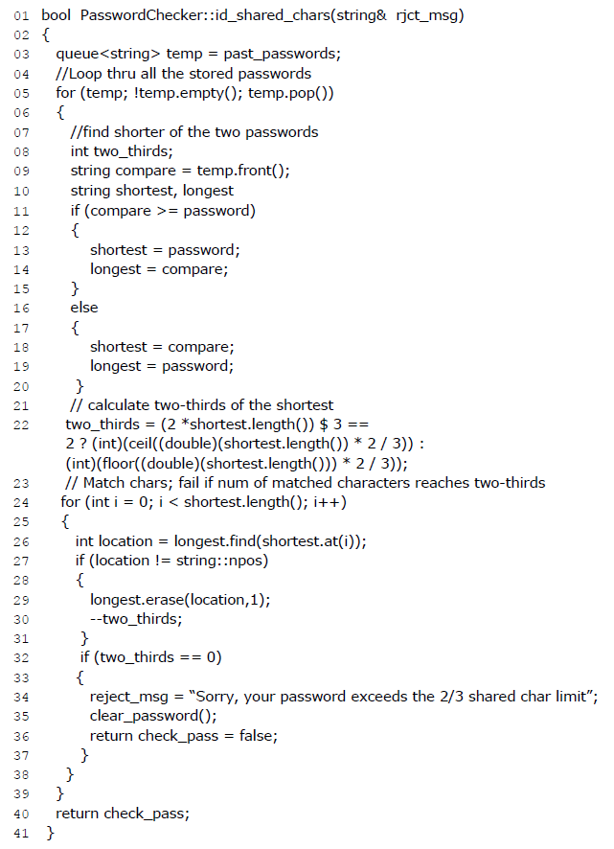
//for loop starting on line 24
//for loop starting on line 5
//method starting on line 1
SO, how might we apply dataflow testing to this code snippet?
let’s look at the variable two_thirds
Note to presenter:
You have an answer, but you shouldn’t reveal it until
the students have given this question the “college try.”
if there is a path that goes from 08 to 32
(without going through 22 & 30),
there is potential for a code defect
Question: What kind of testing is Dataflow Testing?

Slide 11
Let’s have a look inside…
pass out clickers…

Slide 12
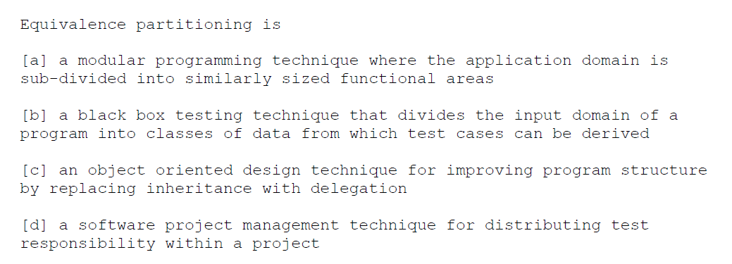
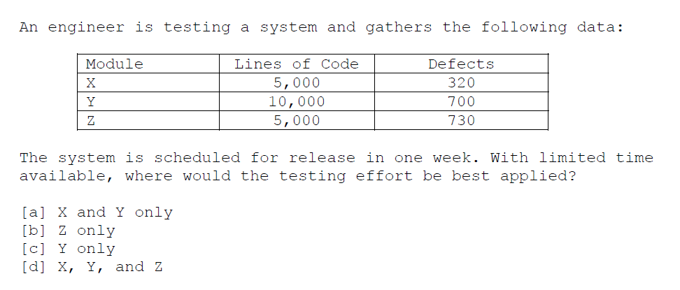
(Note to presenter: Let the class read, and then vote)

Slide 13
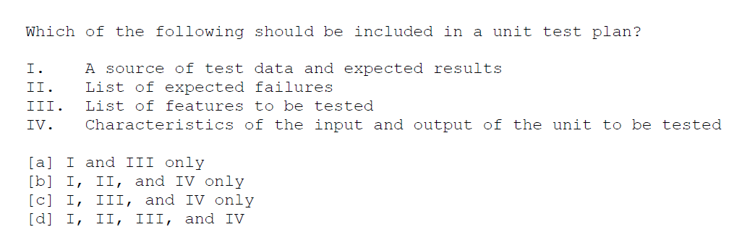
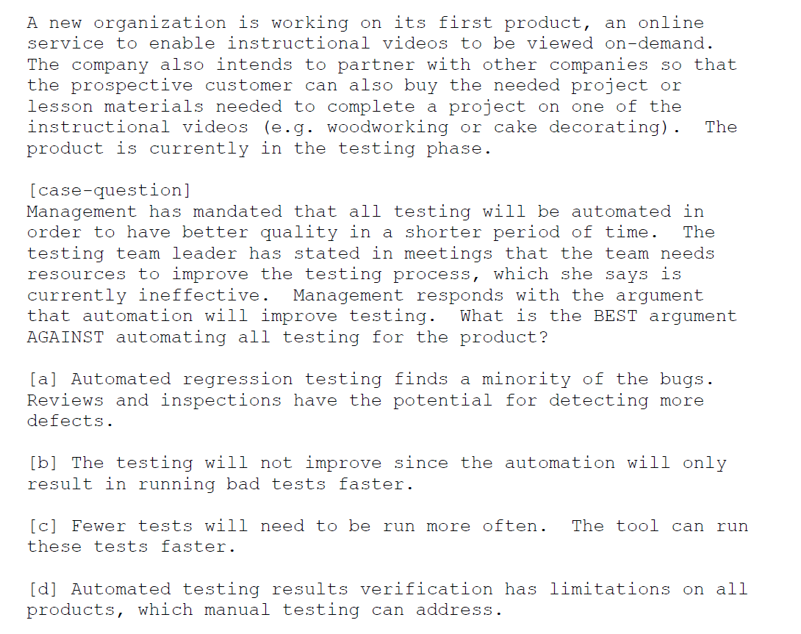

Slide 14
HOMEWORK 6 / Project 3
White Box Testing Exercise
Start with the code you wrote for to detect “similar passwords” due to “identical substrings” in Project 2. (This assignment might be easier if this code is in its own class or subroutine.)
Draw a flow graph of your code. Calculate McCabe’s complexity metric for this flow graph. To continue with this assignment, it must be at least 5 and no more than 10. (If it is not, either find another segment of your code to analyze, or refactor your code.)
Analyze the resulting flow graph to determine what would be needed to achieve statement, branch, and path coverage.
Create a set of paths that achieve each one. (In the case of path coverage, you can limit this to simple paths if your code has loops).
Check to see if your 30-case test plan achieved statement and branch coverage. If it did, provide a set of test cases that achieved the coverage. If it did not, show which test cases achieved most of the coverage, and then add new test cases for the uncovered paths.
This is HW6.
This is Proj 3.

Slide 15
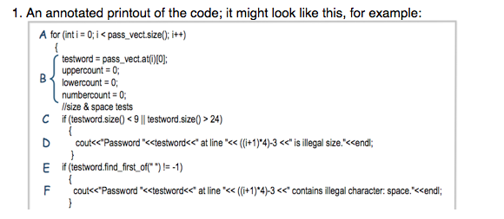
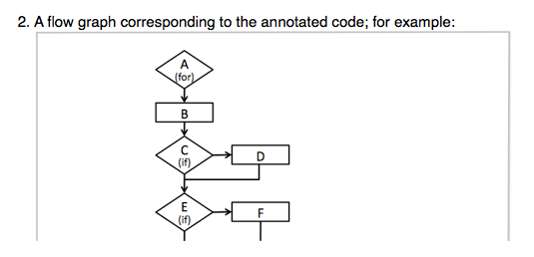
Here are some examples…
NOTE: You can use letters or numbers.
If you use letters, and there are more than 26
nodes, use double letters (AA, BB, CC, DD, etc.)
If there are more than 52 nodes, use numbers.

Slide 16
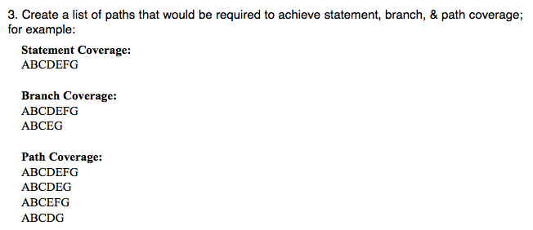

Slide 17
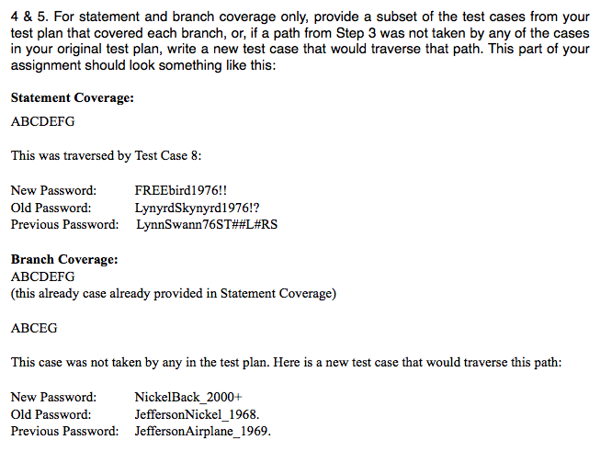

Slide 18
Due Dates are Negotiable
Option A:
HW6 is due Monday, Nov 9
Proj 3 is due Monday, Nov 16
Option B:
HW6 is due Monday, Nov 16
Proj 3 is due Monday, Nov 23
Option C:
HW6 is due Monday, Nov 16
Proj 3 is due Monday, Nov 30
No class on Wednesday, Nov 11 (Veteran’s Day)
Thanksgiving is Thursday, Nov 26

Slide 19
This slide intentionally left blank

